Slide 1
BI Visualization Project
By Elizabeth MacCready

Slide 2
Business Questions
Which state sold the most products by volume last year?
Which store made the most profit last year?
What are the top 5 products in terms of revenue for each year?
What is the trend of the different channel sales revenue by month?
How are stores performing against target sales by month for?

Slide 3
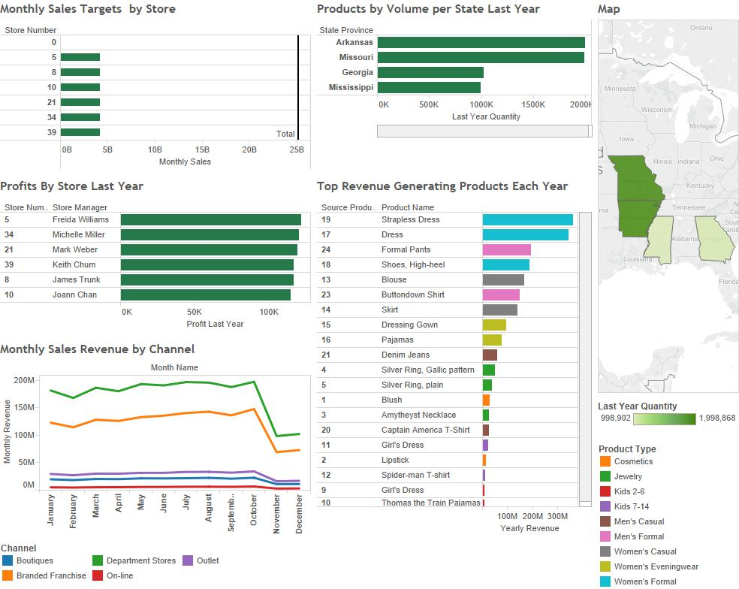
BI Dashboard
Dashboard

Slide 4
Dashboard Visualizations
Chose Tableau for its ability to easily connect to DB and the quality visuals
Bar charts for most solutions due to ease of legibility and lack of confusion
Added a map for business question 1
Arranged graphics layout according to importance of business questions
Chose colors that look nice but are subdued so it’s easy to focus on the data

Slide 5
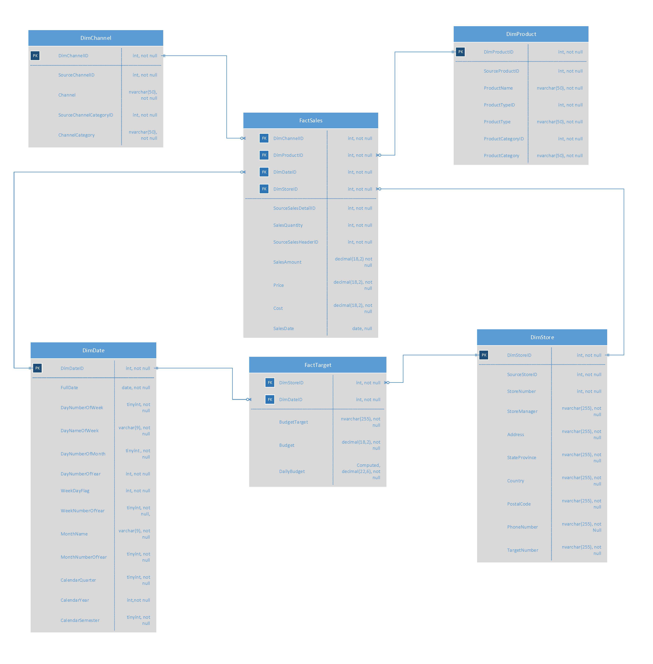
Dimensional Model

Slide 6
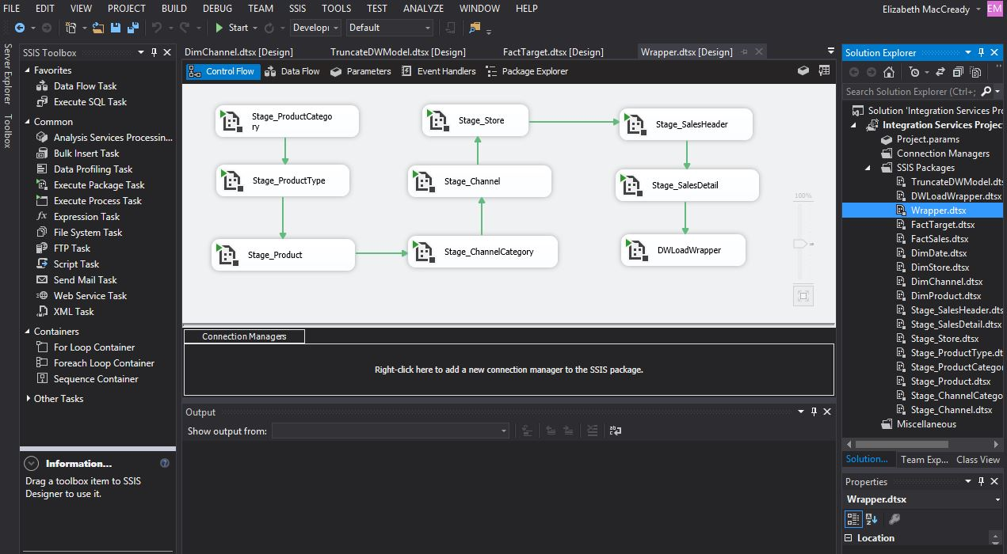
ETL Staging and Dimensional Model Load

Slide 7
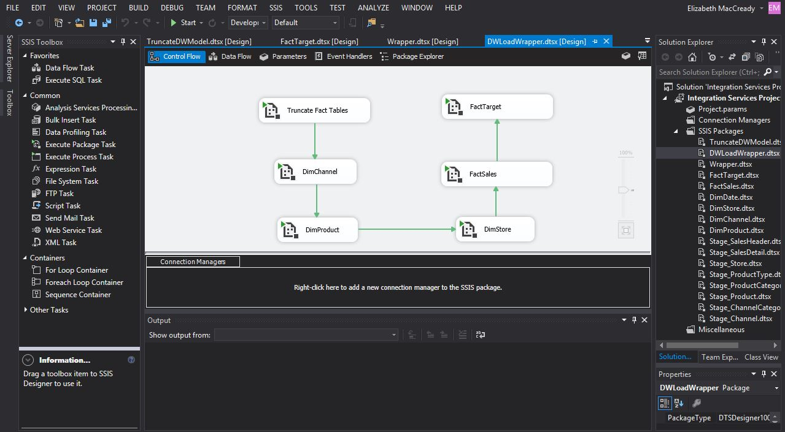
Dimensional Model Truncate and Load

Slide 8
Key Challenges
Truncating, Deleting, and Reseeding Dimension Tables
SQL and Query skills overall
Fact Tables, Joins, Null Values
Tableau data wasn’t always showing up like my queries
Scrolling and filtering by date as a drill down feature in Tableau

